Slide 1
Tuskegee Partnership to Provide Technology and Cyber-security Experiences to Alabama Black Belt through Mobile Application Development Years of Funding: 2021-2025 MIT APP Inventor – Chapter 10
Dr. Paramjit Kahai
This research is supported by NSF grant # P2048884awarded to Tuskegee and Auburn Universities

Slide 2
Chapter 10: Sensors

Slide 3
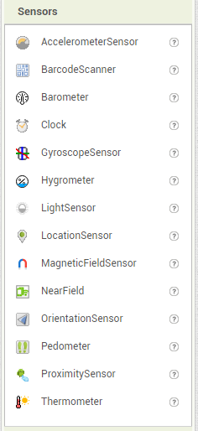
Sensors
Smartphones have sensors that can help read the world around them which is a great data source for apps to use.

Slide 4
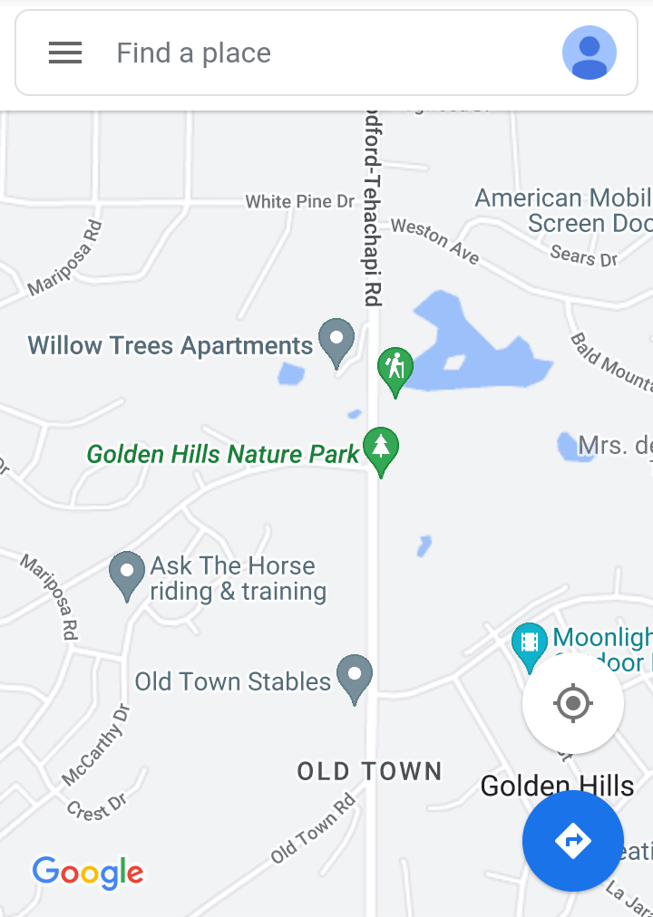
Using Location
GPS is one of the most common sensors that people use on their phones.
It uses satellites in orbit around Earth to triangulate an exact location.

Slide 5
The Location Sensor
MIT App Inventor has the Location Sensor component for accessing location data and has many properties, including the big three of location: latitude, longitude and altitude.
Notice the two event handlers: LocationChanged and StatusChanged.
LocationChanged event records a new location in a list every time it changes.
StatusChanged event is triggered when the device is no longer able to see the GPS satellites.

Slide 6
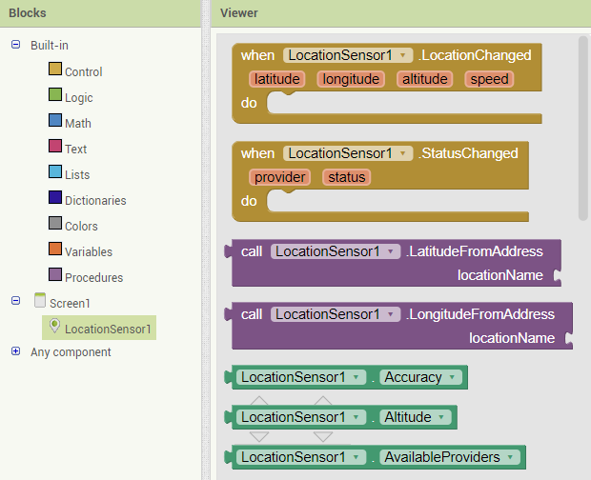
The Location Sensor
Both provider and status are pieces of text, so you can display them and see what has changed about the status.
If status has the piece of text Available in it, then you know you have a location.

Slide 7
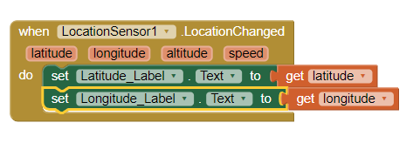
Location Data
Location is a set of numbers: latitude and longitude.
Get location sensors using getter blocks and in the LocationChanged event as parameters.
Two versions of the LocationChanged event: One gets the location data from the events parameters, and the other from the components properties.

Slide 8
Location Data
If your app asks for latitude, longitude, current address, or any other location data, App Inventor simply reports "Unavailable" because it can't find a lock on current location, you can use HasLongitudeLatitude by Location sensor to find the lock.
HasAccuracy and HasAltitude also tell you whether the phone has either of those pieces of information.

Slide 9
Using the Maps App with Intents
A piece of location data opens a mapping app.
To activate another app on an Android phone, the current app must send a special signal to the Android operating system, called an intent.
An intent is a request to handle something.
Most Android phones have Google Maps installed, and that is usually the default mapping app.
An intent bearing geographic data thus will be handled off to Google Maps.

Slide 10
Using the Maps App with Intents
To generate an intent signal, you need to have an Activity Starter component. Drag it from the Connectivity palette in the Designer to your app, and then it appears in the nonvisible components area.
The Activity Starter needs two properties: Action and DataUri.
Set the Action property to precisely android.intent.action.VIEW. This means whatever data we give it as the DataUri will be viewed by an appropriate app.
Let's have the intent deliver the current address of the phone.
Let's create a button called Show_Map_Button that will trigger this.

Slide 11
Using the Maps App with Intents
When the button is clicked, it will set up the intent and then call StartActivity, which will send the intent to the operating system.
Be sure to add the StartActivity block at the end.
The geo: tag at the beginning is the key to being interpreted as location data.

Slide 12
Saving Location Data
A location is just a small set of numbers, so we can save it like any other number.
We can store latitude and longitude in a pair of global variables, We can add them to a list.
Keep in mind that global variables, including lists stored in them, keep data only as long as the app is running.
To save your data so that it reliably comes back, store them to the phone's local persistent storage with TinyDB.

Slide 13
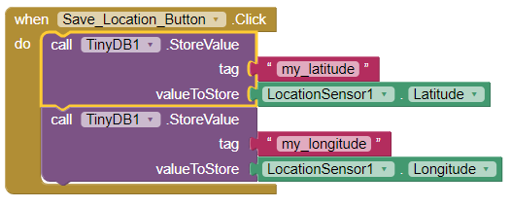
Saving Location Data
Let's store an address in a set of global variables.
Now let's store that data so we can remember it for later using TinyDB.

Slide 14
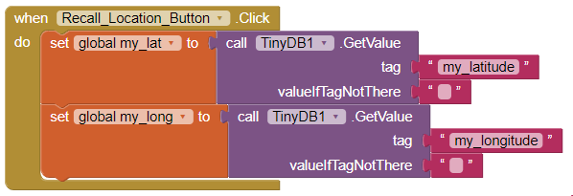
Saving Location Data
To recall data, take the data back out of TinyDB and store it in the global variables from earlier.

Slide 15
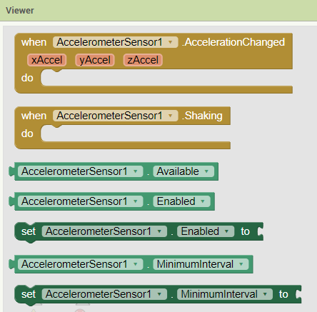
The Accelerator
Smartphones have a device known as an accelerator that measures the acceleration being applied to the phone.
The accelerator can also detect more subtle accelerations which are frequently used in games.
Users often can tilt or move their devices to impact game play.

Slide 16
Detecting tilt
The accelerometer can detect very subtle accelerations in three directions (x ,y and z).
Gravity constantly applies a downward acceleration to every object on earth.
A phone lying flat on the table, not moving, the only acceleration present is gravity which will be read on the z-axis.
If the phone were moved left or right, it would be read on the x-axis.
If the phone were slid forward on the table, it would read on the y-axis.
If we wanted an app that detected right/left tilt, we could look at the x-axis and know that zero means perfectly flat, negative means tilting one way, and positive means tilting the other way.

Slide 17
The Orientation Sensor
Another way to detect tilt is to use the Orientation Sensor which gives a direct reading of tilt and angle.
It tells how the phone is oriented relative to the Earth. This sensor provides roll, pitch and azimuth data.
Imagine the phone as an airplane: top(earpiece) is nose of the plane, bottom(home button) is the tail end.
The roll is how much the plane rotates without the tail or nose moving.
The pitch is how higher or lower the nose is than the tail.
The azimuth tells how the phone is pointed relative to magnetic north, effectively serving as a compass reading.
Not all Android devices have this feature.

